Slide 1

Presentation title goes here
If you have a subtitle, or want to explain the purpose of the presentation, put that here. Remember, less is more!

Slide 2
Content slide example – your title here
Text goes here – keep it short and sweet.
Your slides should support your presentation with relevant points – don’t write everything you want to say here, put it in the notes.

Slide 3

Use strong, bold images like this

Slide 4
Facts or figures
Subheading here
List goes here
Bullet point 1
Bullet point 2
Bullet point 3
Bullet point 4
List goes here
Bullet point 1
Bullet point 2
Bullet point 3
Bullet point 4
List goes here
Bullet point 1
Bullet point 2

Slide 5
Content slide example – your title here
Need additional slides? Simply right click on this slide in the left hand panel and click ‘duplicate slide’.

Slide 6
Statistics
Subheading
Statistic 1
48%
Statistic 2
18%
Statistic 3
98%
Statistic 4
53%
Notes:
MENTION PRE-DOMINANT END OF LIFE CARE ON COOMBES.
PAUL – MENTION HOW WE WORK WITH OUR COMMISSIONERS AND ACUTE CARE PROVIDERS. BIS provides rehab whereas SNH provides disability management (SS is a mixture of both depending on the funding stream). This will set expectations early on as no doubt some relatives will mention it as they often expect the same therapy input as that provided on BIS.
Mention that all of SNH has GP led model, but in Specialist Services its variable. On S/S is unusual in that it has mixed patient and resident group – CHECK DOROTHY. MIXTURE ON WELLSLEY OF LONG TERM CARE AND SHORTER TERM REHAB.
220 people here, split BIS/SS/SNH, but spread out around the RHN.
Clarify difference between rehab and disability management
UNIQUE – TONY POPS IN/SALLY HOLDS MY HAND. ALL HAVE A PART TO PLAY IN THE DAILY LIFE OF OUR PATIENTS AND RESIDENTS
We offer personalised goal planning for all patients and residents

Slide 7
Bullet points example – your title here
Bullet points help to make your slides more readable.
Try not to have more than three or four bullet points per slide.
If you have lots to get across, try going onto another slide – it’ll be easier to follow.

Slide 8

Notes:
Another way to use large images

Slide 9
“Use quotes like this her
“You don’t need to use italics as they’re hard to read.”
“Don’t make quotes too long.”
Notes:
working hard to improved the patient flow through the hospital by reducing the length of stay of approrpriate patients

Slide 10
Another way to display lists
Subheading
Item 1
Item 2
Item 3
Item 4

Slide 11
Short bullet points
Bullet 1
Bullet 2
Bullet 3
Bullet 4
Bullet 5
Bullet 6

Slide 12
Another way to display facts
Neurology for Huntington’s
(twice per week)
Respiratory
(twice per month)
Neuro-psychiatry
(once per week)
Respiratory for ventilator unit (once per week)
ENT (once per month)
Respiratory nursing (twice per month)
Radiology
(once per week)
Palliative care (twice per month)
Specialist dentistry
(twice per week)
Microbiology

Slide 13
A way to display charts Subheader
Chart 1
Bullet point 1
Bullet point 2
Bullet point 3
Bullet point 4
Chart 2
Bullet point 1
Bullet point 2
Bullet point 3
Bullet point 4
Chart 3
Bullet point 1
Bullet point 2
Bullet point 3
Bullet point 4

Slide 14
More charts Subheader
Chart 2
Bullet point 1
Bullet point 2
Bullet point 3
Bullet point 4
Chart 3
Bullet point 1
Bullet point 2
Bullet point 3
Bullet point 4
Chart 1
Bullet point 1
Bullet point 2

Slide 15

More bold images

Slide 16
Another way to display info
Info here
Info here
Info here
Info here
Info here
Info here
Info here
Info here
Info here
Notes:
Particularly mention:
Chaplaincy
Music Therapy
Outings
16

Slide 17

Any questions?
Notes:
John has been resident at the RHN since 1978.

Slide 18
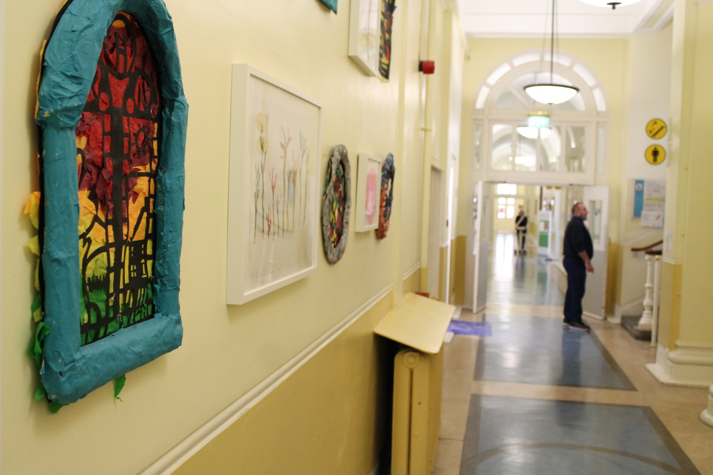
Thank you

Slide 19

Our mission and
values
Our Mission
Providing outstanding care and empowering individuals with neuro-disability, enabling them to live their lives to their fullest potential in accordance with their wishes.

