Slide 1

StatStrip® Glucose/Ketone xpress 2™ meter
Operator Training

Slide 2
Your Training Session
Agenda
StatStrip Glucose/Ketone Overview Meter
StatStrip Glucose Testing Overview Quality Control Patient Testing Reviewing Data
Practical ‘Patient Test’ and QC Test
StatStrip Ketone Testing Overview Quality control Patient Testing
Basic Maintenance
Contact
Complete Training Documentation
Learning Outcomes
Carry out blood glucose and ketone patient tests using the Nova Biomedical StatStrip Xpress Glucose/Ketone Meter Understand the importance of the meter and basic maintenance requirements, including how to carry out a quality control test and how the meter should be kept Complete tests within MHRA guidelines for point of care glucose testing and obtain reliable results
Notes:
We’ll start with an interactive presentation during which you will perform a test in front of one of us followed by a quiz (you might want to take notes). Please make a note of any questions you have during the presentation and there will be time later to answer those with you.
Even though you have meters in front of you, please wait until we tell you to have a go on them, otherwise you are likely to get lost and slow down proceedings for your colleagues.
DO NOT LEAVE without your barcode or, if you are not happy – please speak to one of us…..

Slide 3
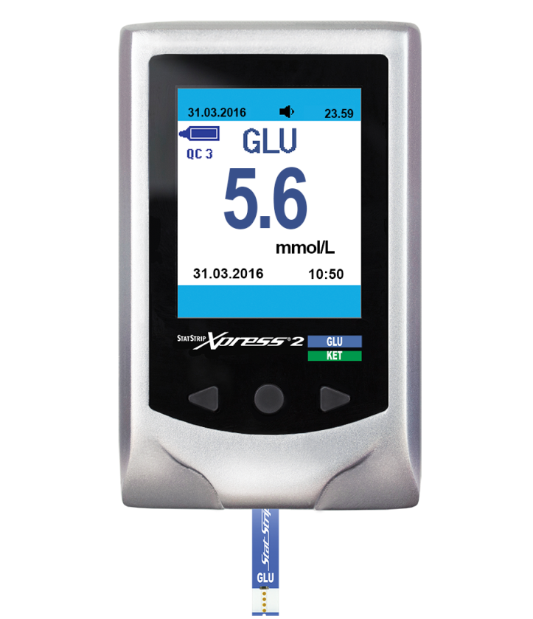
StatStrip Xpress2 Glucose/Ketone Meter
Each ward will have 2 Meters
LCD Display
Result
mmol/L
Left Arrow button
Right Arrow
Mode Button
Glucose Test Strip

Slide 4


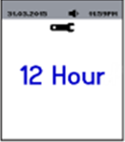
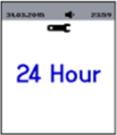
Meter Setup Following Battery Replacement
Replacement batteries for Xpress2 meters available from Acute Care Room
Set the Time
Press the MODE button for longer than 3 seconds.
The meter if in Sleep Mode wakes up and enters the SETUP Mode.
Press the left or right arrow button to toggle between the 2 time format options, either 12Hr or 24 Hr.
Press the MODE button to accept the hour format.
The meter displays the current time or the default time with the hour digits flashing.

Slide 5


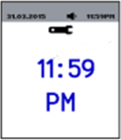
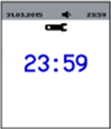
Meter Setup Following Battery Replacement
Replacement batteries for Xpress2 meters available from Acute Care Room
Set the Time
Press the left or right arrow button to toggle between the 2 time format options, either 12Hr or 24 Hr.
Press the MODE button to accept the displayed hour.
Press the left or right arrow button to set the minutes. Scroll from 00 to 59
Press the MODE button to accept the displayed hour choice.

Slide 6


Meter Setup Following Battery Replacement
Replacement batteries for Xpress2 meters available from Acute Care Room
Set Date Format
Choose to have the date displayed as DD.MM or MM-DD. Press the right or left arrow button or arrow button to toggle between the 2 options
Press the MODE button to accept the displayed date format. The year should be flashing

Slide 7



Meter Setup Following Battery Replacement
Set Date Format
Press the right or left arrow button or arrow button to select the current year
Press the MODE button to accept the displayed year. The year should be flashing
Year Setup Month Setup
The month should be flashing press the right/left arrow button to scroll through the 12 months (1-12)
Press the MODE button to accept the displayed year. The year should be flashing

Slide 8
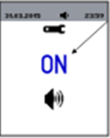
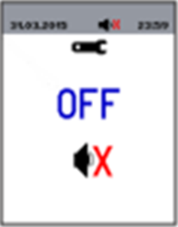
Beeper On and Off
Select the left and right arrow buttons to toggle between beeper ON or OFF (flashing)
Press the MODE button to accept the displayed ON or OFF

Slide 9
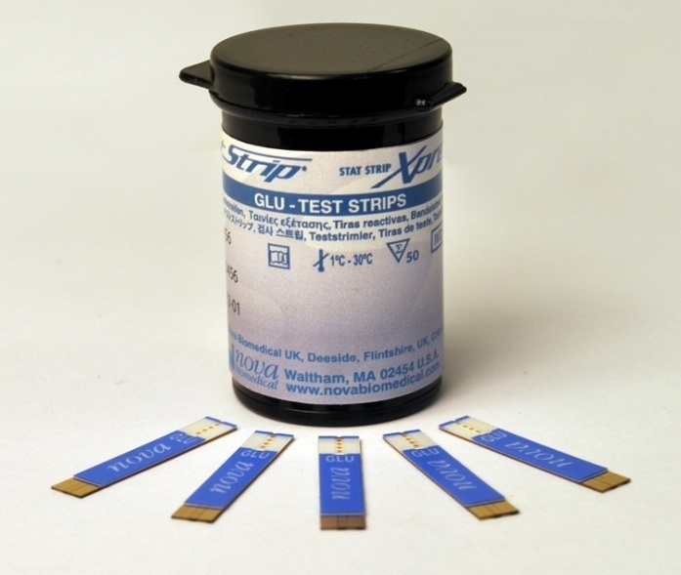
StatStrip Glucose Strips
No known interferences
No calibration required
End-fill, capillary draw
1.2 µL sample size
Order from internal pharmacy via RHN intranet
Once opened strips stable for 6 months – discard date must be written on vial & checked before use

Slide 10
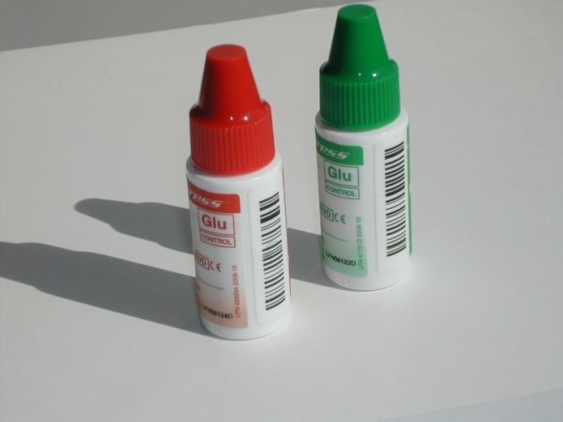
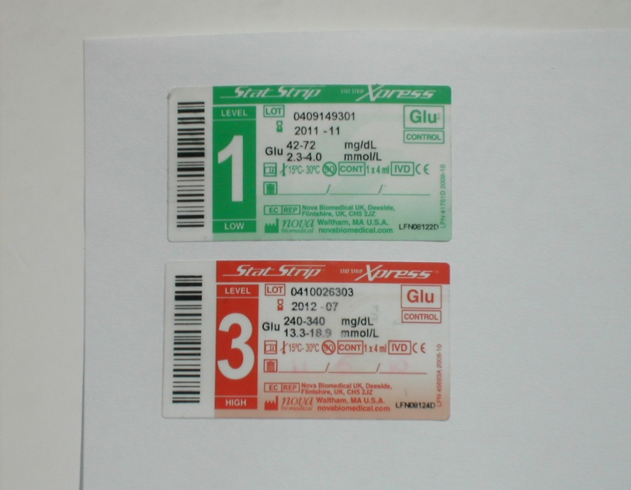
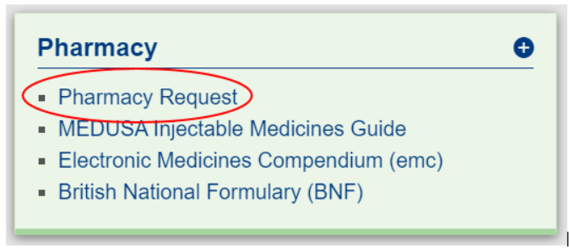
Quality Control Solutions
Once opened stable for 3 months – always write discard date on bottles & check before use
Always shake the bottle and discard the first drop before use
The lot number and which level you are using is on the side of the bottle
QC Solutions are obtained from the internal pharmacy.
Order via RHN intranet – pharmacy request

Slide 11
Running a quality control sample

Slide 12
Quality Control Regime
QC testing checks that
  The meter in working correctly
  That you have the correct technique
QC testing is mandatory
Two levels (level 1 & level 3) should be performed every twenty four hours

Slide 13


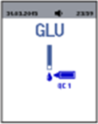
Running a QC Test
Insert a glucose test strip into the meter. A test strip and blood drop will display.
QC1 or QC3 Should be selected and displayed on screen prior to the sample being applied
Identify the sample as a QC control; use the left or right arrow button to find the desired control level C1 or C3

Slide 14

Running a QC Test
Gently shake the quality control solution before each use.
Discard the first drop of control solution from the bottle to avoid contamination
Touch the end of the test strip to a drop of the control solution until the test strip fills and the meter beeps
Please note: A quick beep sounds when sufficient control solution has been applied to the test strip

Slide 15
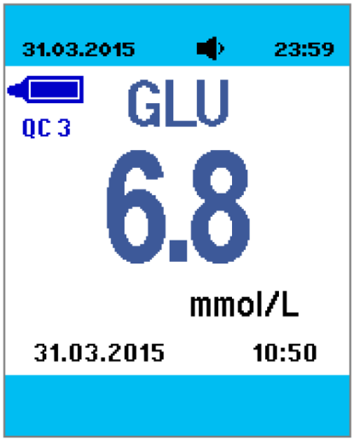
Running a QC Test
Quality control test results are available in 6 seconds on the meter screen
There is 1 long beep when the results are ready
There are 3 short beeps if test results are outside of the measurement rang of the test strips
Ensure the result falls between the reference range indicated on the QC vial
Complete the QC log book
Remove the test strip and discard into an appropriate biohazard container

Slide 16
Quality Control Regime
Following your QC result:
Write the QC test result on the QC Log book
Check the result sits between the first and third mmol/l range on the QC Solution bottle. Ignore the middle number – This is the mean of the two ranges.
You MUST make sure you check your result falls within range. This determines if the QC
has passed/failed.
Please make sure you document all the information required on the QC Log Book (see
example). This is a legal document and MUST be completed correctly.

Slide 17
What to do if QC fails….
If QC has failed
Check correct QC level was used
Check the expiry of the QC level and test strips
Repeat test to check technique
If QC still fails
Use a different QC bottle and repeat
If QC still fails
Use a different vial of test strips and repeat
If QC still fails contact the Clinical Response Service, who will arrange for the meter to be replaced and serviced.

Slide 18
Running a patient sample

Slide 19
Before Taking a Patient Sample…
Observe clinical presentation of patient.
Explain procedure to patient & obtain consent if possible.
Wash own hands thoroughly & put on gloves according to local Policy.
Ensure patient’s hands are clean and dry and free from contaminants. Wash hands with soap and water. Alcohol wipes may be used(ensure alcohol has dried before obtaining sample)
Common contaminants – fruit juice, fizzy drinks, sweets, newspaper ink, patient’s own soap.

Slide 20
Obtaining a Capillary Sample
Perform the finger prick on patient
Obtain patient blood sample ensuring:
  Use a new sterile lancet each time
  Prick the side of the patient’s finger
  Remember not to use the thumb or index finger
Venous or arterial blood samples may also be used.

Slide 21
Patient Testing
Obtaining a capillary sample may be difficult or inappropriate if the patient is:
Severely dehydrated
Hypotensive
In Shock
In Peripheral Circulatory Failure
In such circumstances use venous or arterial sample
This device cannot be used to make a diagnosis of diabetes
Notes:
Capillary samples can be difficult to obtain in patients with these conditions – this is due to peripheral shutdown. If you are having to squeeze the finger a lot to get a sample, stop and think. This sample will be diluted with damaged tissue fluid if you continue and that would give a misleading result as well as cause the patient discomfort.
You can use a venous or arterial sample with the StatStrip meter, so there are alternatives.

Slide 22

Running a Patient Test
.
NOTE:
Do NOT test patient samples
where QC test results fall outside of the expected range
Insert a test strip into the strip port then a test strip with a blood drop will be displayed

Slide 23
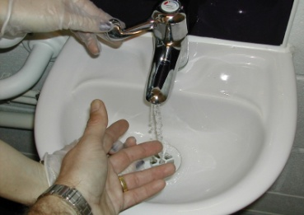
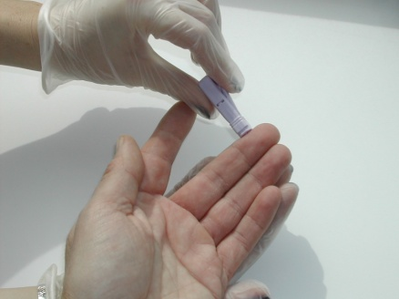
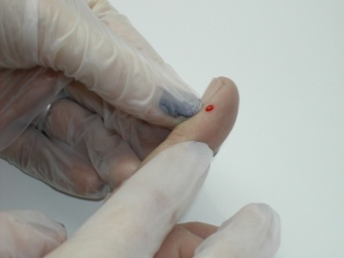
Patient Preparation
Wash patient’s hand thoroughly and massage finger to stimulate blood flow.
Ensure patients hands are warm this too will help blood flow.
Use safety lancet to puncture finger – use the final 3 fingers, on the sides only, not the pads. Puncture heels on neonates.
Do not squeeze finger to form blood drop.
It is good practice to discard the first drop of blood.
WARNING: The test strip must fill completely upon touching the blood droplet. If the test strip does not fill completely in the first instance, do not touch the test strip to the blood droplet a second time. Discard the test strip and repeat the test with a new strip.

Slide 24
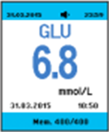
Glucose Results Display
There is one long beep when the results are ready
There are three short beeps if the test results are outside of the measurement range of the test strip (0.6-33.3 mmol/L)
Remove the test strip and discard into a biohazard container

Slide 25
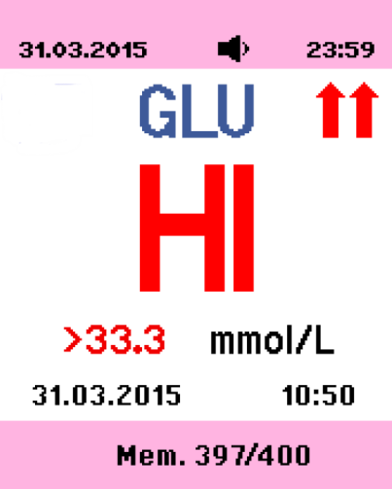
Interpreting Patient Results
Report abnormal or unexpected results to nurse in charge or doctor
Xpress2 glucose meter reads between 0.6 - 33.3 mmol/L
If result is less than 0.6 mmol/L,
meter displays LO
If result is greater than 33.3mmol/L,
meter displays HI

Slide 26
After You Have Finished the Test…
Discard the test strip safely into the biohazard container
Discard the used lancet into the biohazard container
Decontaminate the meter
Write the result into the patient’s notes and inform staff in charge of patient if required

Slide 27
External Quality Assurance – EQA
It is mandatory to participate in the EQA scheme in line with Trust policy
Every 2 months a test sample is delivered to each department with an explanatory letter
The test must be performed on all meters in the department. It can be done on anyone trained to use the meters by following the written instructions and the result must be scanned and emailed to the clinicalresponservice@rhn.org.uk

Slide 28
Maintenance & troubleshooting

Slide 29
Maintenance
Cleaning the Meter
The meters should never be immersed in any cleaning agent. Always apply the cleaning agent to a soft cloth to wipe the meter surface. Once complete, immediately dry thoroughly.
When cleaning the meter, please follow the guidelines listed below:
• 70% Isopropyl Alcohol may be used.
• Commercial surface decontamination preparations that are approved for use by your facility can be used. Apply to a small test area first to ensure surface finish integrity.
• Avoid harsh solvents such as benzene and strong acids.
CAUTION: DO NOT immerse the meter or hold the meter under running water.
DO NOT spray the meter with a disinfectant solution.
Do not leave used lancets/strips in the box, clean the workstation as required
Change battery as necessary

Slide 30
Maintenance – Replacing the batteries
The meter is powered by 2 AAA batteries.
Install/Replace the batteries as follows:
Remove the battery pack cover on the meter
Install 2 AAA batteries. Make sure the positive (+) and niegative (-) ends are facing the correct direction
Replace the battery cover. The software version and default date and time will appear for 3 seconds.

Slide 31

Troubleshooting - Error Codes
There are 8 error codes to inform you of problems with the meter. The error code displays after the test strip is inserted and the Segment screen displays for 2 seconds. There are also 3 quick beeps. Then the error code is displayed on the screen.
E0 Software Error
A software error has been detected.
Action: Perform the test again. If you
get the same error again, remove and
re-seat the battery.

Slide 32


Troubleshooting - Error Codes
E1 System Hardware Error
A system hardware error has been detected.
Action: Perform the test again.
E2 Operating Temperature Error
The meter temperature is outside of the range for testing.
Action: Move the meter to an area where the temperature is acceptable (5 - 40°C), allow meter to adjust to the temperature. Repeat the test.

Slide 33


Troubleshooting - Error Codes
E3 Used Strip Error
The test strip was previously used.
Action: Repeat the test with a new test strip.
E4 Short Sample Error
Insufficient sample volume (Control or blood) was drawn into the test strip.
Action: Repeat the test with a new test strip.

Slide 34


Troubleshooting - Error Codes
E5 Strip not recognised Error
The test strip is not recognised.
Action: Repeat the test with a new test strip.
E8 Bad Strip Error
The test strip is defective or bad.
Action: Repeat the test with a new test strip.

Slide 35

Troubleshooting - Error Codes
E9 Bad Sample Error
A problem was detected with the sample.
Action: Repeat the test with a new test strip.

Slide 36
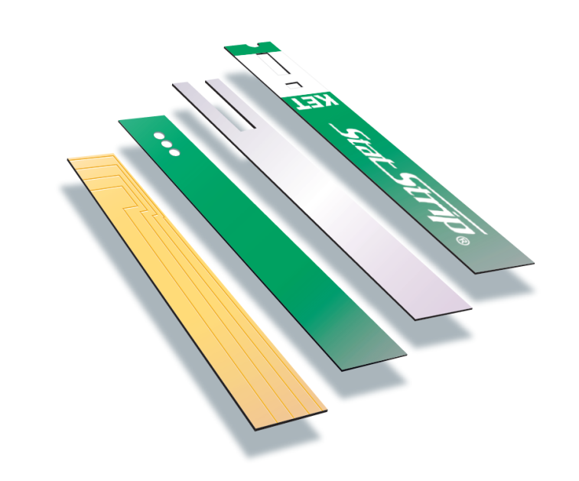
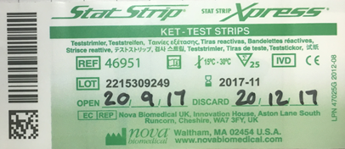
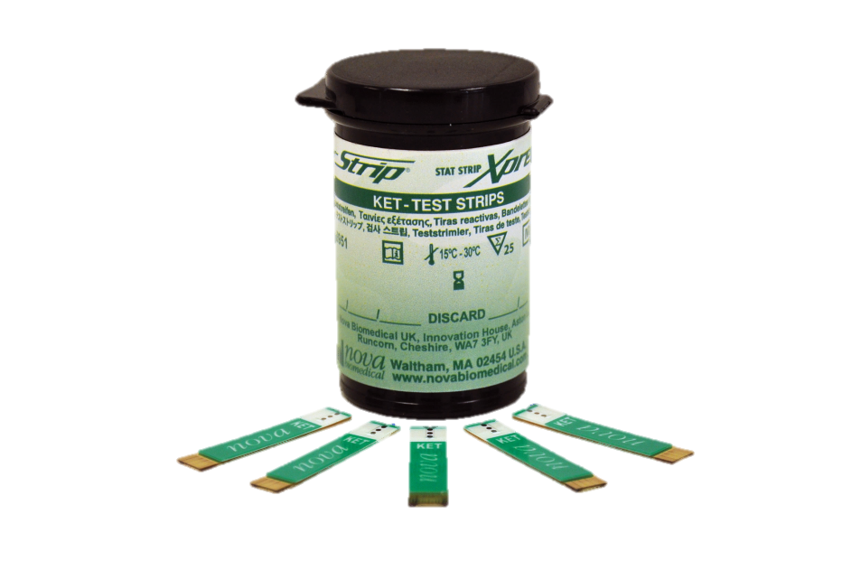
StatStrip Ketone Test Strips
No known interferences
No calibration required
End-fill, capillary draw
Order from internal pharmacy via RHN intranet
Once opened strips stable for 3
months – discard date must be
written on vial

Slide 37
Ketone Testing
0.8µL sample size
Capillary and venous blood can be used
10 second analysis time
Ketone reporting range 0.0mmol/L to 8.0 mmol/L results outside of this range will be displayed as HI on the patient result screen
Always follow Trust guidelines
Capillary and venous blood can be used

Slide 38
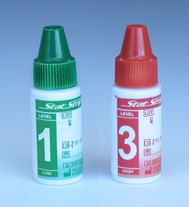
Ketone QC Testing
Use the same QC solutions for glucose
and ketone testing
QC testing will only be required prior to a
patient test for ketones, unless already
run in the last 24 hours

Slide 39
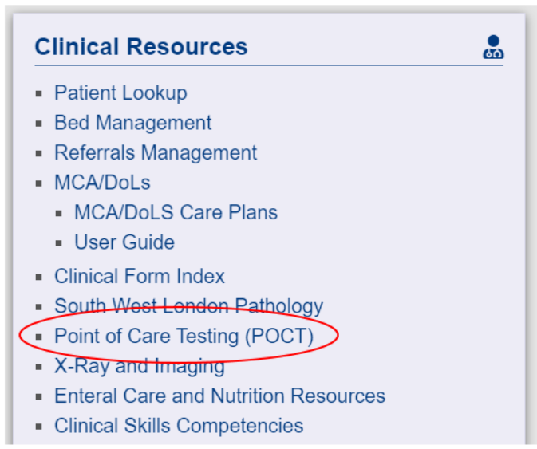
Contacts
For queries or support with point of care testing (POCT),
please contact the Clinical Response Service (CRS):
clinicalresponseservice@rhn.org.uk
Extension: 6471
Resources for point of care testing can be accessed via the RHN intranet under clinical resources:

Slide 40

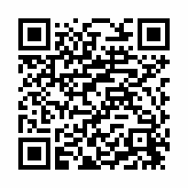
Please could you leave us your feedback to help us
monitor and improve our training sessions and materials.
Feedback can be left anonymously using the survey link or the QR code:
https://survey.alchemer.com/s3/6384664/Nova-UK-Point-of-Care-Meter-Training
Notes:
We’ll start with an interactive presentation during which you will perform a test in front of one of us followed by a quiz (you might want to take notes). Please make a note of any questions you have during the presentation and there will be time later to answer those with you.
Even though you have meters in front of you, please wait until we tell you to have a go on them, otherwise you are likely to get lost and slow down proceedings for your colleagues.
DO NOT LEAVE without your barcode or, if you are not happy – please speak to one of us…..

