Slide 1
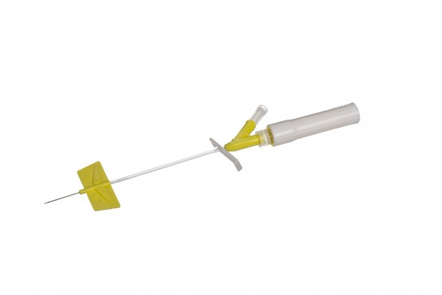
Subcutaneous (Hypodermoclysis) insertion of BD Saf-T-Intima Safety System

Slide 2
Hypodermoclysis insertion
Subcutaneous insertion of BD Saf-T-Intima Safety System
WATCH THE VIDEO
https://www.youtube.com/watch?v=BpMUPQ21eEo

Slide 3
Recommended sites for subcutaneous injection include the lateral aspects of the upper arm and thigh, and the umbilical region of the abdomen (Ogston-Tuck, 2014; Hunter, 2008). The back and lower loins can also be used (Fig 2).

Slide 4
A lifted skinfold technique (pinching or bunching the skin) can be used to lift the subcutaneous layer away from the underlying muscle (Down and Kirkland, 2012) (Fig 3).

Slide 5
Drugs administered by the subcutaneous route are deposited into subcutaneous tissue (Fig 1); small volumes (up to 2ml) of non-irritant, water-soluble drugs can be administered by subcutaneous injection (Dougherty and Lister, 2015). Frail patients and elderly and have little subcutaneous tissue, therefore injection / insert the saf-t at a 45-degree angle.

Slide 6
Prescription for PRN / As Required subcutaneous injections
Prescribed on PRN side on EPR
IF symptoms are observed – ACT!
Follow up and document the effectiveness
IF not worked – TRY something else
Follow up and document the effectiveness
If a syringe driver is present best practice – insert another butterfly for PRN use only

