Slide 1
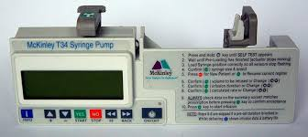
Setting Up a Continuous Subcutaneous Injection (CSCI)
(T34 McKinley Syringe Driver Pump)

Slide 2
Prescription for CSCI – T34 McKinley Syringe Driver Pump
Prescriptions for the syringe driver are found on EPR under infusions

Slide 3
Nurses syringe driver administration chart

Slide 4
How to set up the syringe driver – You Tube video
***Please be aware that at RHN we will be using 30ml BD Plastipak syringes (made up to 22mls with WFI) not the 20mls syringe shown in the video***
https://www.youtube.com/watch?v=yyKUUWTL_vw
How to set up the equipment – You Tube video
***Please be aware that at RHN we will be using 30ml BD Plastipak syringes (made up to 22mls with WFI) not the 20mls syringe shown in the video. Please ensure you select the correct syringe type when setting it up***
https://www.youtube.com/watch?v=GTR9Wn8LkcA

Slide 5
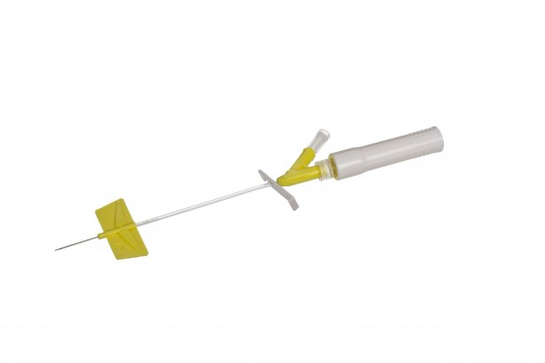
Hypodermoclysis insertion
Subcutaneous insertion of BD Saf-T-Intima Safety System
https://www.youtube.com/watch?v=BpMUPQ21eEo

